Slide 1
ReD: A Policy Based on Reuse Detection for Demanding Block Selection in Last-Level Caches
Javier Díaz¹, Pablo Ibáñez¹, Teresa Monreal²,
Víctor Viñals¹ and José M. Llabería²
¹ Aragón Institute of Engineering Research (I3A), University of Zaragoza, and Hipeac
² Departament d'Arquitectura de Computadors, Universitat Politècnica de Catalunya and Hipeac

Slide 2
Basic ideas
A block selection / bypass policy
Can be combined with any other insertion, promotion and victim selection algorithms
Demanding
Blocks classified dead on arrival and bypassed by default
Reuse-based. Blocks are stored only
if reuse is detected: the second time they are requested
or if their requesting instruction has shown to request highly-reused blocks

Slide 3
A block selection / bypass policy
Without selection, most blocks are not requested again from the LLC after they are stored
Selection has major potential
Approach
Focus in block selection as a separate problem
Enable combination with other components of the replacement policy

Slide 4
Demanding Reuse-based approach
Most blocks are not requested again from the LLC after they are stored
By default: blocks classified dead on arrival and bypassed
Blocks accessed at least twice tend to be reused many times
Our main goal: to detect the second request to a block
We need to remember addresses of requests that have recently missed in the LLC
Inspired in the Reuse Cache (Albericio et al.)

Slide 5
Address Reuse Table (ART)
Remembers addresses that have recently missed in the LLC
Miss in ART → first request to a block → bypass LLC, insert into ART
Hit in ART → second or later request to a block → store block in LLC
Each ART is a set-associative buffer
Separated from the LLC
Unaffected by decisions of the base replacement policy
More simple to implement
Private for each core
Increases fairness of the reuse detection between threads
Diminishes inter-core thrashing in the LLC

Slide 6
The need for a secondary mechanism
Using only the ART a block with reuse experiences two LLC misses
To avoid one miss → predict the reuse pattern at the initial request
Secondary mechanism
Detects instructions that request highly-reused blocks
Enables storing blocks requested by those instructions at their initial request
Requires remembering the past behavior of instructions and blocks → requires the ART

Slide 7
Program Counter - Reuse Table (PCRT)
Tracks the reuse of blocks requested by each instruction (PC)
Two counters per entry: #reused and #notreused
They keep the number of addresses that a PC inserts in ART and are finally reused or not
A PC with reuse probability higher than ¼ sends all initial requests to the LLC
PCRT also used to reduce the insertion of addresses in ART
PCs with reuse probability very high (>¼) or very low (<1/64) only insert 1 in 8 times

Slide 8
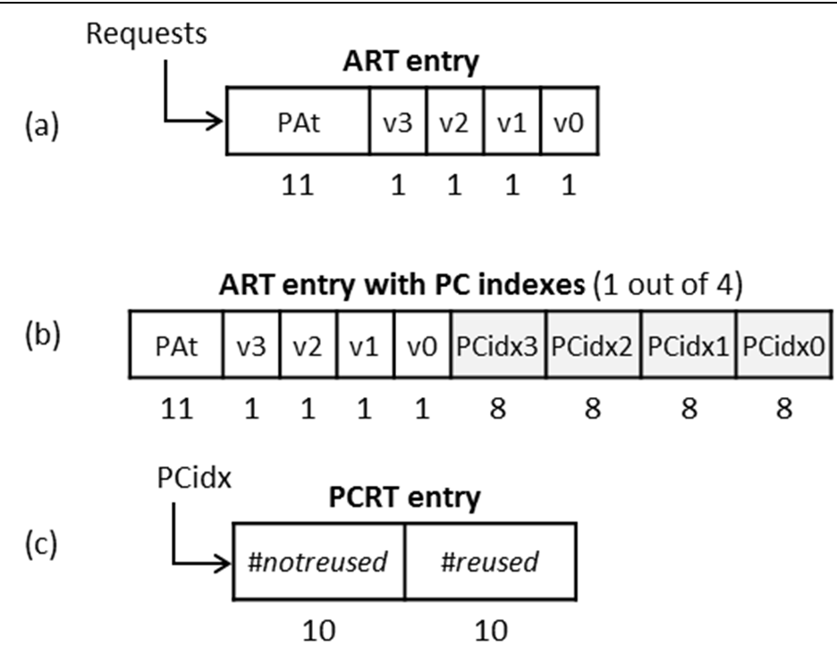
ART and PC-RT entries
ART
Indexed by block address
One entry tracks 4 blocks
PAt: Partial Address tag
4 valid bits
ART with PC indexes
4 PC indexes
PCRT
Tagless
Indexed by 8 bits of the PC
Two 10-bit counters

Slide 9
Example
State of ReD internal tables after two initial requests (1) (2), and a first-reuse request (3). ART set shown uses PC sampling

Slide 10
Other details
Base replacement policy: 2-bit SRRIP
On insertion, only applied if ReD decides not to bypass
We also tried with 3p-4p with similar results
No distinction between prefetch and demand requests
Write-back requests
Ignored by ReD
If they miss, they are allocated in the LLC but with minimum priority

Slide 11
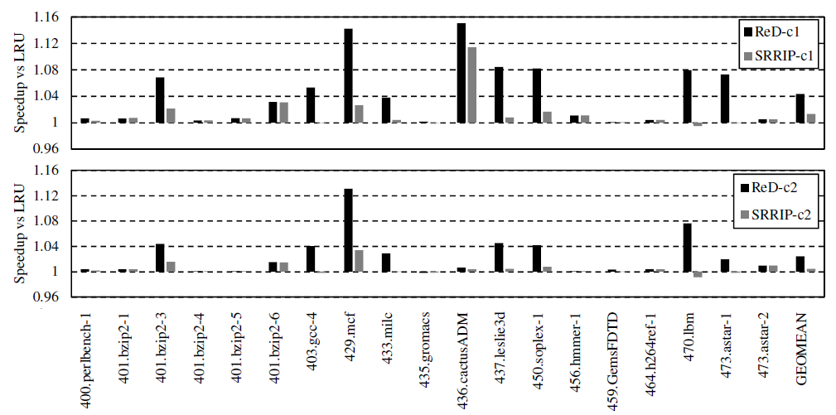
Results: speedup in single-core configs
1.044
1.024

Slide 12
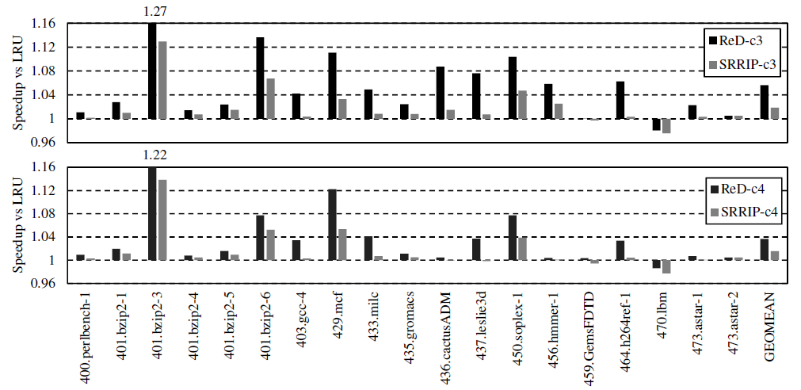
Results: speedup in multi-core configs
1.056
1.036

Slide 13
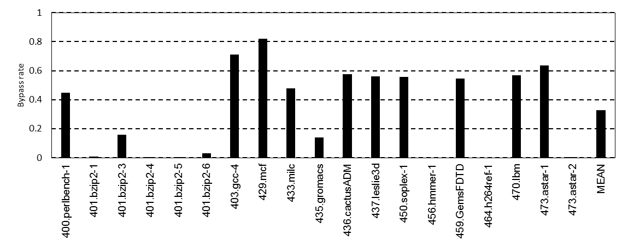
Results: bypass rate (c1)

Slide 14
Thank you

Slide 15
Backup

Slide 16
ART details
One ART per core
Set-associative buffer with 16 ways and 512 sets
FIFO replacement policy
Partial address tags, 11 bits
An entry tracks four consecutive LLC blocks
Four valid bits per entry
15616 bytes per core

Slide 17
PCRT details
PCRT is tagless and has 256 entries
Indexed by 8 bits of the trigger PC
Two 10-bit counters per entry
When a counter reaches its maximum, both counters of the entry are divided by two
We need to store in ART the PC that requests each address
Set sampling in ART: only ¼ of the ART entries include PC information
640 bytes per core
8192 bytes per core

